Slide 1
Development of master curricula for natural disasters risk management in Western Balkan countries
University of Pristina in Kosovska Mitrovica
Dr Jelena Djokic
Faculty of Technical Sciences
Logo of your organization
Kick off Meeting/ 15/12/2016
Nis
Project number: 573806-EPP-1-2016-1-RS-EPPKA2-CBHE-JP
"This project has been funded with support from the European Commission. This publication reflects the views only of the author, and the Commission cannot be held responsible for any use which may be made of the information contained therein"

Slide 2
Short video presentation
Development of master curricula for natural disasters risk management in Western Balkan countries

Slide 3
General Concerns
Development of master curricula for natural disasters risk management in Western Balkan countries
The countries of Western Balkan are exposed to a variety of natural hazards including floods, droughts, forest fires, earthquakes, and landslides.
inadequate professional qualification and technological disciplines for education of human resources,
the lack of specialized personnel, insufficient training of professional staff,
the lack or low level of local government bodies’ preparedness,
underdeveloped culture of prevention among citizens.

Slide 4
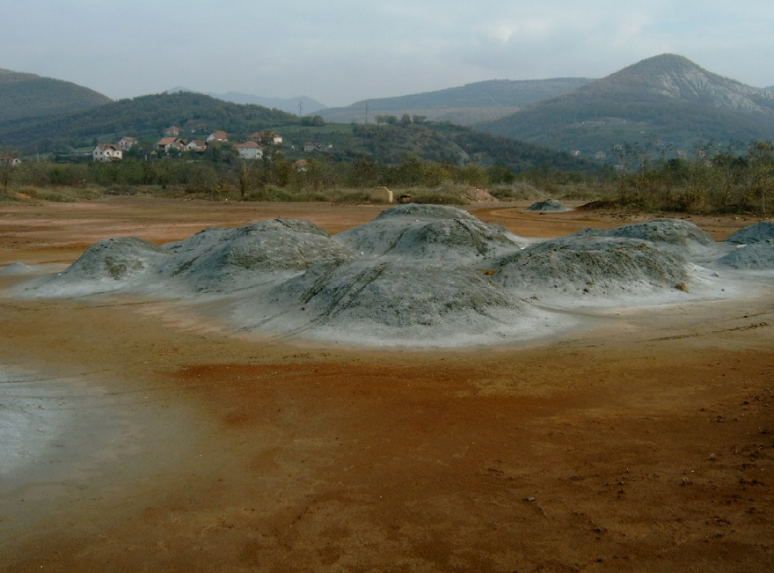
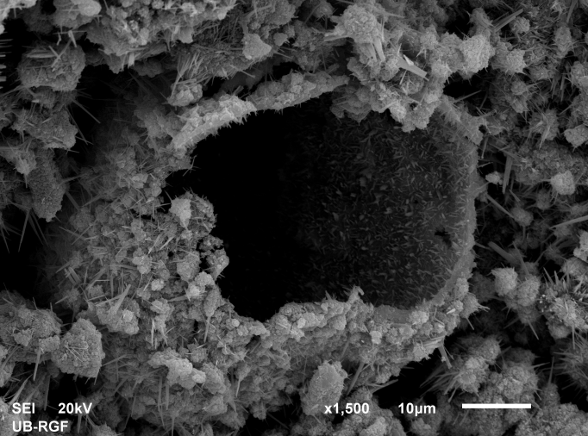
Special Conditions of the Northern Kosovo*-Trepca Legacy
Development of master curricula for natural disasters risk management in Western Balkan countries

Slide 5
Special Conditions of the Northern Kosovo*
Development of master curricula for natural disasters risk management in Western Balkan countries
Industrial waste Landfill 2006
Industrial Waste Landfill 2015

Slide 6
Capacity of the Faculty of Technical Sciences, UPKM starting point:
Development of master curricula for natural disasters risk management in Western Balkan countries
Laboratory for Environmental Engineering
Senior Research staff

Slide 7
Development of master curricula for natural disasters risk management in Western Balkan countries
Conducted research in the field of Monitoring and Modeling and Simulation of the Environmental Accidents, including Natural Disasters impact to the Environment
Participation on the III 43007 project Climate Change Impact to the Environment, analyzing soil, air and surface and ground waters

